Slide 1
Basics of java language
PRESENTED BY:-
RAHUL BAGHEL

Slide 2
CONTENTS
What is Java?
History of Java.
Features of Java.
Where is Java used?
How does Java work?
Java environment.
Object-Oriented Concepts
How to Install Java.

Slide 3
introduction
Java is a high-level, class-based, object-oriented programming language that is designed to have as few implementation dependencies as possible.
Developed by Sun Microsystems.
A general-purpose OBJECT ORIENTED language.
Based on C\C++.
Designed by easy Web\Internet Applications.

Slide 4
History of java
Java developed by Sir James Gosling , Mike Sheridan, And Patrick Naughton At Sun Microsystems In 1991.
Java’s Old Name Was “Oak”.
In 1995 Oak Was Renamed As “Java”.

Slide 5
Features of java.
Simple
Object-oriented
Secure
Platform independent
Multithreaded
Architectural neutral
Distributed
Dynamic
Portable
High performance

Slide 6
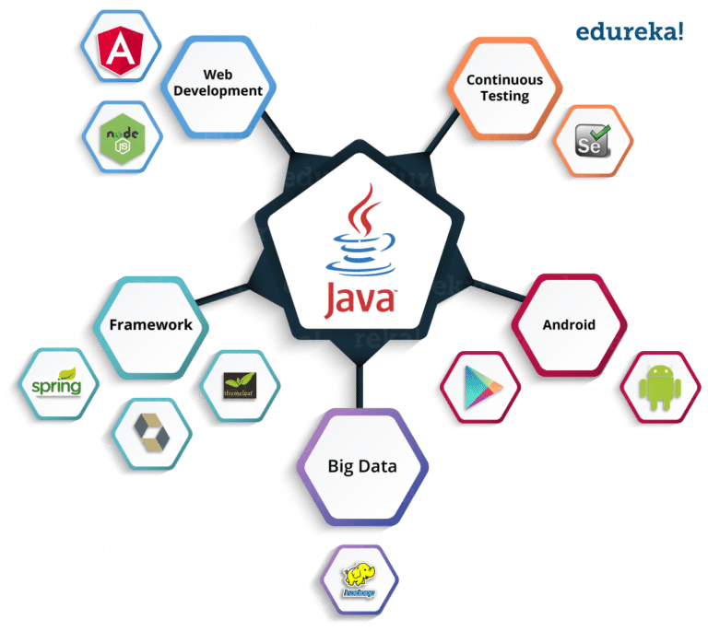
Where is java used?

Slide 7
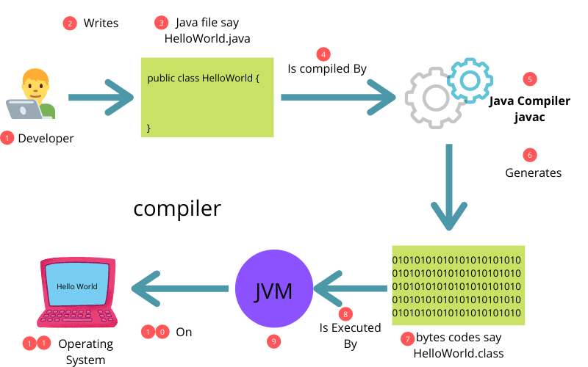
How does java work

Slide 8
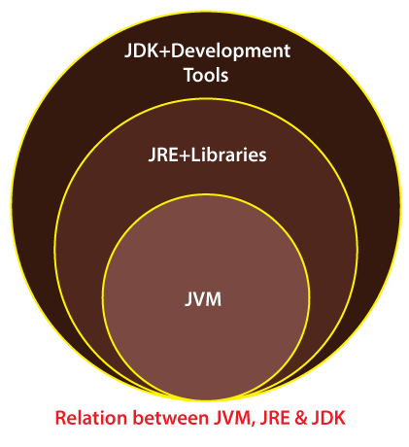
Java environment

Slide 9
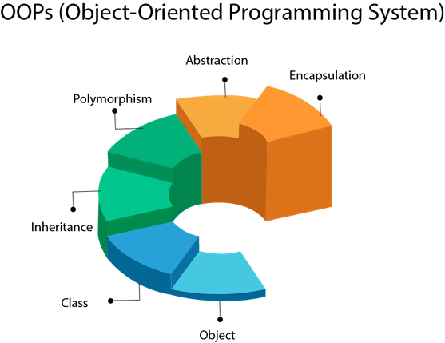
Basics concepts of oops
Object
Class
Inheritence
Polymorshism
Abstraction
Encapsulation

Slide 10
How to install java
Downloading JDK Setup
Installing JDK Setup.
Install JRE Setup.
Install JavaFX Setup.
Configuring JAVA.
Writing First Java Program.
https://www.oracle.com/in/java/technologies/downloads/

Slide 11
THANK YOU

